Slide 1

Advanced NLP (Information Retrieval)
NLP
Dr. Sajarwo Anggai, S.ST., M.T. NIDN : 0421108703

Slide 2
NLP Pipeline
Text Preprocessing
Feature Extraction
Modeling
Post-Processing
Deployment
Segmentation/ Tokenization
Normalization/ Lowercasing
Stopword Removal
Punctuation Removal
Stemming/ Lemmatization
Depedency parsing
Part-of-Speech Tagging
Bag of Words (BoW)
TF-IDF
Word Embeddings
Machine Learning
Deep Learning
Prediction
Evaluation
Fine-Tuning
Production
Monitoring and Updating

Slide 3
Information Retrieval
Information Retrieval (IR) is finding material (usually documents) of an unstructured nature (usually text) that satisfies an information need from within large collections (usually stored on computers).
These days we frequently think first of web search, but there are many other cases:
E-mail search
Searching your laptop
Corporate knowledge bases
Legal information retrieval

Slide 4
Unstructured (text) vs. structured (database)
mid-nineties
today

Slide 5
Basic assumptions of Information Retrieval
Collection: A set of documents
Assume it is a static collection for the moment
Goal: Retrieve documents with information that is relevant to the user’s information need and helps the user complete a task

Slide 6
How good are the retrieved docs?
Precision : Fraction of retrieved docs that are relevant to the user’s information need
Recall : Fraction of relevant docs in collection that are retrieved

Slide 7
Unstructured data in 1620
Which plays of Shakespeare contain the words Brutus AND Caesar but NOT Calpurnia?
One could grep all of Shakespeare’s plays for Brutus and Caesar, then strip out lines containing Calpurnia?
Why is that not the answer?
Slow (for large corpora)
NOT Calpurnia is non-trivial
Other operations (e.g., find the word Romans near countrymen) not feasible
Ranked retrieval (best documents to return)
Later lectures

Slide 8
Term-document incidence matrices
Which plays of Shakespeare contain the words Brutus AND Caesar but NOT Calpurnia?
One could grep all of Shakespeare’s plays for Brutus and Caesar, then strip out lines containing Calpurnia?
Why is that not the answer?
Slow (for large corpora)
NOT Calpurnia is non-trivial
Other operations (e.g., find the word Romans near countrymen) not feasible
Ranked retrieval (best documents to return)
Later lectures

Slide 9
Term-document incidence matrices
1 if play contains word, 0 otherwise
Brutus AND Caesar BUT NOT Calpurnia

Slide 10
Incidence vectors
So we have a 0/1 vector for each term.
To answer query: take the vectors for Brutus, Caesar and Calpurnia (complemented) ➔ bitwise AND.
110100 AND
110111 AND
101111 =
100100

Slide 11
Bigger collections
Consider N = 1 million documents, each with about 1000 words.
Avg 6 bytes/word including spaces/punctuation
6GB of data in the documents.
Say there are M = 500K distinct terms among these.

Slide 12
Can’t build the matrix
500K x 1M matrix has half-a-trillion 0’s and 1’s.
But it has no more than one billion 1’s.
matrix is extremely sparse.
What’s a better representation?
We only record the 1 positions.
Why?

Slide 13
Can’t build the matrix
For each term t, we must store a list of all documents that contain t.
- Identify each doc by a docID, a document serial number
Can we used fixed-size arrays for this?
Brutus
1
2
4
11
31
45
173
174
Caesar
1
2
4
5
6
16
57
132
Calpurnia
2
31
54
101
What happens if the word Caesar is added to document 14?

Slide 14
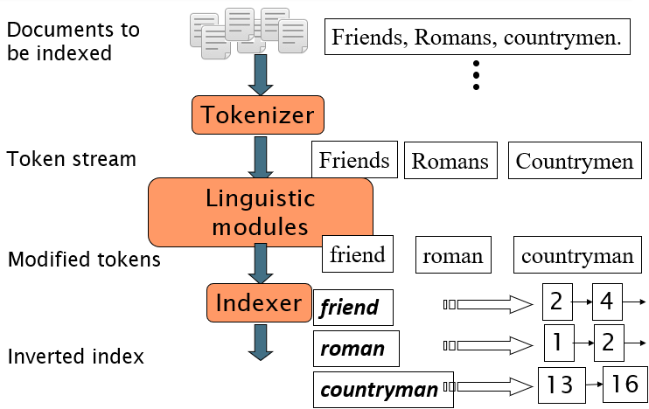
Inverted index construction

Slide 15
Ref
https://nlp.stanford.edu/IR-book/information-retrieval-book.html
https://web.stanford.edu/class/cs276/
https://courses.cs.washington.edu/courses/cse454/09sp/slides.html

Slide 16
Tugas
Cari 10 jurnal terkait dengan Information Retrieval!
Buatlah program Inverted Index untuk menampung corpus/dataset!

Slide 17

Universitas Pamulang
Prodi Teknik Informatika S-2
Sajarwo Anggai
Dosen – Universitas Pamulang
NIDN : 0421108703
Email : dosen02832@unpam.ac.id
Terima Kasih

